Slide 1
Numbers
TMS1113 :Foundation of Mathematics

Slide 2
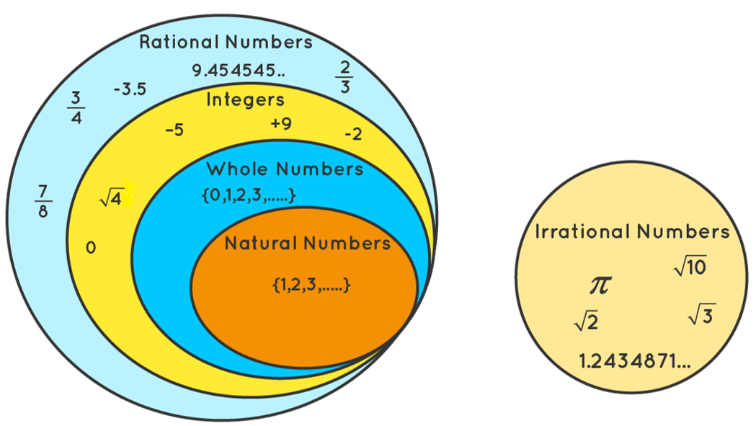
Numbers
Understanding Different Types of Numbers

Slide 3
What Are Numbers?
Numbers are mathematical objects used for counting, measuring, and labeling.
Broadly categorized into
  natural numbers,
  integers,
  rational numbers,
  irrational numbers, and
  prime numbers.

Slide 4
Natural Numbers
Definition: Natural numbers (ℕ) are the counting numbers starting from 1: 1, 2, 3, 4, ...
Examples: 1, 5, 108, 1000
Properties:
- No fractions or decimals
- No negative numbers
- Do not include 0
Set notation: N = {1, 2, 3, 4, 5, ...}
Exercise: Identify whether the following are natural numbers: -3, 0, 7, 21, 3.5

Slide 5
Whole Numbers
Whole numbers are natural numbers plus zero.
Examples: 0, 1, 2, 3, 4, 5, ...
Properties:
- Start from 0
- Includes all natural numbers
- No negative numbers, fractions, or decimals
Set notation: W = {0, 1, 2, 3, 4, ...}
Every natural number is a whole number,
but not every whole number is a natural number (because 0 is not natural).

Slide 6
Numbers
Understanding Different Types of Numbers

Slide 7
Integers
Definition: Integers (ℤ) include all whole numbers, both positive and negative, and zero.
Examples: ..., -3, -2, -1, 0, 1, 2, 3, ...
Z = {..., -3, -2, -1, 0, 1, 2, 3, ...}
Properties:
- Closed under addition, subtraction, and multiplication [eg: 5 + (-3) = 2, -4 × 3 = -12]
- Not closed under division [eg: 5 ÷ 2 = 2.5 → not an integer]
Exercise: Determine which of these are integers: 7, -9, 0.5, -11, 4.3, 0

Slide 8
Rational Numbers
Definition: Rational numbers (ℚ) are numbers that can be expressed as a fraction p/q, where p and q are integers and q ≠ 0.
Examples: 3/4, -2, 0.25, 0.333...
Key Points:
- Every integer is a rational number (e.g., 5 = 5/1)
- Terminating and repeating decimals are rational numbers
Exercise: Write the following decimals as fractions: 0.5, -0.75, 1.2

Slide 9
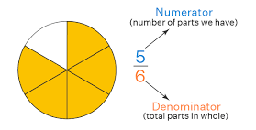
Fractions
Numerator and Denominator

Slide 10
Write the following decimals as fractions: 0.5, -0.75, 1.2
0.5
0.5 = 5/10 = 1/2
-0.75
−0.75 = −75/100 = −3/4
1.2
1.2 = 12/10 = 6/5​

Slide 11
Irrational Numbers
Definition: Numbers that cannot be expressed as a fraction p/q.
Examples: π, √2
Key Points: Their decimal representation is non-terminating and non-repeating.
Exercise: Identify irrational numbers from the following: √4, π, √3, 0.333..., 2

Slide 12
Identify irrational numbers from the following: √4, π, √3, 0.333..., 2
√4 = 2 (a rational number because it can be written as 2/1)
π ≈ 3.141592653... (irrational because it never terminates or repeats) ✅
√3 ≈ 1.732... (irrational because it never terminates or repeats) ✅
0.333... = 1/3 (a rational number because it is a repeating decimal)
2 (a rational number because it can be written as 2/1)

Slide 13
Prime Numbers
Definition: A prime number is a natural number greater than 1 that has no divisors other than 1 and itself.
Examples: 2, 3, 5, 7, 11, 13
Properties:
- 2 is the only even prime number
- All other prime numbers are odd
Exercise:
- Identify the prime numbers from: 12, 17, 23, 25, 31, 36
- Find all prime numbers between 1 and 50

Slide 14
Real Numbers ℝ
Real numbers are all the numbers that can be represented on the number line
They include both rational and irrational numbers
Eg:
Positive numbers, Negative numbers, Zero Fractions,
Decimals (both repeating and non-repeating), integers

Slide 15
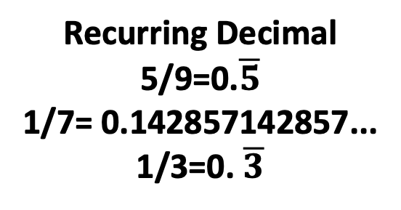
Real Numbers ℝ
Rational Numbers ℚ
(p/q, q ≠ 0)
Irrational Numbers
(infinite decimal)
√2 = 1.41421
π= 22/7 = 3.14159
Integers ℤ
-1, 0, 1, 2,….
Fractions
Finite Decimal
3/4
Recurring Decimal
5/9=0.$\overline{5}$
1/7= 0.142857142857...
1/3=0. $\overline{3}$

Slide 16
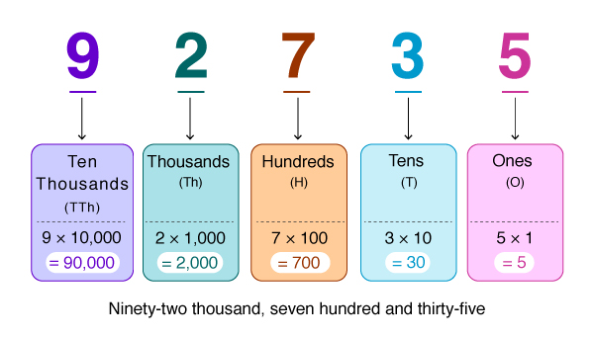
Place Value of Numbers

Slide 17
Mixed Exercises
1. Classify the following as natural, integer, rational, or irrational: -7, 0, 3.14, √5, 8
2. Write 0.333... as a fraction.
3. Find the next five prime numbers after 50.

Slide 18
-7
  Integer (since it's a whole number, but negative)
  Rational (can be written as -7/1)
0
  Integer (whole number)
  Rational (can be written as 0/1)
3.14
  Rational (since it's a terminating decimal, it can be written as a fraction)
√5
  Irrational (since the square root of a non-perfect square is a non-repeating,
  non-terminating decimal)
8
  Natural number (positive counting number)
  Integer (whole number)
  Rational (can be written as 8/1)

Slide 19
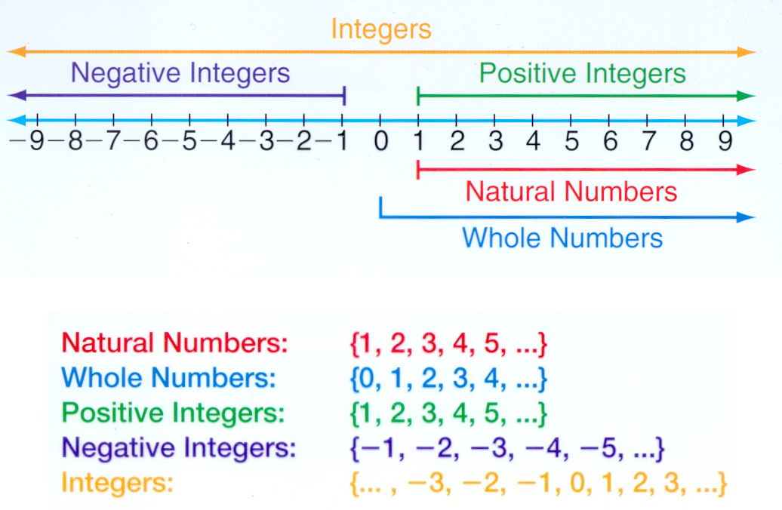

Slide 20
Summary
Natural Numbers: Counting numbers starting from 1
Integers: Whole numbers including negatives
Rational Numbers: Numbers expressed as p/q
Irrational Numbers: Non-terminating, non-repeating decimals
Prime Numbers: Natural numbers divisible by only 1 and itself

Slide 21
1. Integers
(-8) + 5 = ? →
(-4) × 6 = ? →
(-3) × (-7) + 2 = ?
Arrange in ascending order: -2, 3, -8, 0, -5

Slide 22
Convert 0.75 into a fraction.
Is 1.5 a rational number?
Express -5/8 as a decimal.
Simplify: 2/3 + 3/4

